Slide 1
CPSO using Spatially Meaningful Neighbors
PSO
Notes:
Good Morning everyone.
I’m here today to talk about what I am working on for my 4F90 and the pieces that go into it.
My topic is “CPSO using Spatially Significant Neighbors”. That’s a bit of a mouthful so I’m going to break it down and hopefully form some sort of narrative to
Show how we arrived at this topic and why we believe this combination could work together to lead to better optimizations.
So I’m going to start at the beginning and focus on PSO.

Slide 2
What is PSO?
Notes:
I was asked to go into detail on PSO and think Preston is also going to discuss PSO so I apologize if there is overlap but I imagine there will be.
So What is PSO?
PSO (or Particle Swarm Optimization) is a computational intelligence algorithm for optimizing continuous functions.
Like many computational intelligence algorithms, it models its actions based on behaviors found in nature. In this case, PSO attempts to replicate the flocking patterns of bird or maybe more apropos, the swarming tendencies of insects. When birds or insects are looking for food, they work as a team to find the best possible location. They take advantage of their numbers to examine a larger part of the land and communicate their findings to the group.
PSO utilizes this same approach the examine the search space of a potential problem and return the best value found in the group.

Slide 3
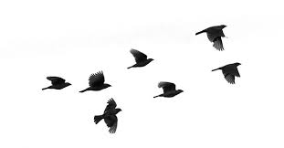
Follow The Leader
Leader
Velocity
Position
Notes:
So how does PSO implement this behavior?
Looking more into the flocking patterns of birds we can see movements similar to that of a “follow the leader” mentality. The birds will approach the bird that is ‘leading the pack’ or in other words is seemingly heading toward the best result. If another bird finds a better area, that bird then becomes the leader and the flock will follow him.
Now, looking at the individual birds in 3D space. We can note the birds movement is represented with 2 main attributes. Those being the current position the bird is at, and the velocity the bird is moving. We can use those attributes almost directly in our implementation.

Slide 4

Global Best
1
Global Best
Particle
Actual Best
Personal
Best
Solutions
Notes:
In implementing this pattern we can instead picture these birds as potential solutions on a graph. These solutions we will refer to as ‘Particles”
Similar to the birds, the particles will have a position and a velocity. The position will represent the input values we are inputting into our optimization problem.
In some cases, these will be a single value but a lot of times the optimization problems are more complex and require more inputs. The number of inputs add to the dimensionality of the problem.
This graph is a representation of a 2 dimensional problem that has 2 inputs (visibly represented on the x and y axis).
The positions need to be run through the function we are trying to optimize to find the particles ‘fitness’. Of the particles, the one in the group (or ‘swarm’) that has the best value is considered the ‘global best’.
This information gets passed to all the particles in the swarm and they will begin to head towards this global best (or ‘leader’)
As they are moving, their positions are constantly being tested against the fitness function. If a particle happens to find a better value along the way, it then becomes the leader.

Slide 5
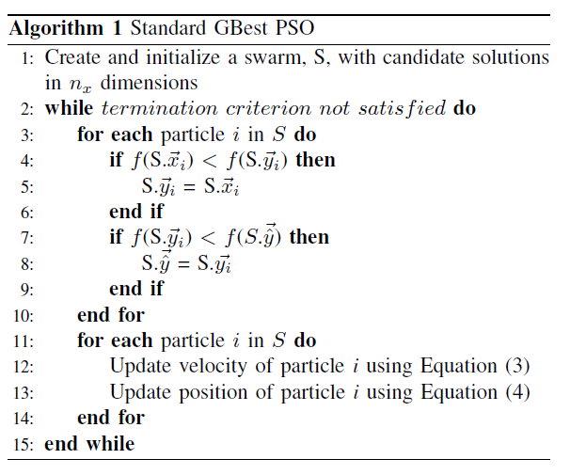
Algorithm
Notes:
So let’s get straight into the algorithm implementation of this. As you can see, there isn’t much to the main PSO algorithm.
Going line by line, we can see we first initialize the swarm and randomize the positions of the initial particles.
We then loop through cycles where, for each particle, we run it’s current value through the fitness function to determine the fitness of it’s current position.
We then compare to see if that value is better than the particle’s personal best (or best value the individual particle has found up to this point) and also see if it’s better than the overall global best (i.e. it is becoming the new leader). It is important to update these each cycle since they both will effect the future movement of the particle.
After updating these values we will then go through each particle and update their velocity and position every cycle.

Slide 6

Update Velocity
Inertia component (ω) – influence of the previous computed velocity Random, stochastic component
Cognitive component (c1) – influence of the personal best position found (pbest )
Social component (c2) – influence of the swarm collective via the global best position found (gbest)
(r1,r2) – uniform random vectors with component values between 0 and 1
Notes:
Here is the function to update the velocity of the particle.
This looks a little complicated but is much easier to understand when you break it down into it’s 3 components.
First is the inertia component. It dictates how much impact the current velocity has on the future velocity. Having a high inertia makes it more resistant to new information and will have it less quickly adjust to the movements of the global best.
Then there is the cognitive component. This dictates how much the particles personal best value effects the velocity.
The social component dictates the global best value.
Finally, it inject a bit of randomness, we also want to add some uniformly random vectors to continually change the influence with each iteration.

Slide 7

Update Position
Notes:
Now updating the position is as simple as taking that new velocity and adding it to the current position of the particle.

Slide 8
Follow The Leader
Leader
Notes:
One thing you will notice about the previous PSO algorithm is the only ‘social interaction’ between the particles in the swarm is from the leader to the rest of the swarm. ‘Non-leader’ particles have no way of sharing information between other particles.
This can lead to a more ‘naiive’ search as it is common for swarms to converge quickly to the global best without adequately searching the entire search space.

Slide 9

Neighbor Cooperation
Notes:
To combat this, a number of different techniques were tested to have particles share information. Neighborhood Topologies have been tested to allow different combinations of which particles should be able to trade with which particle

Slide 10
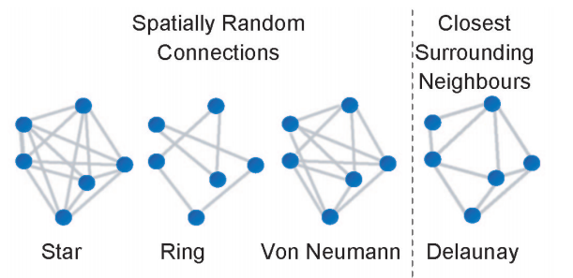
Neighborhood Topologies
Notes:
Connected particles are free to share information, but only connected particles.
The star topology connects all particles together, ring randomly connects particles in a chain (i.e. only 2 connections per particle) and von neumann allows for 4 per particle.
All of the topologies have varying results.

Slide 11
PSO Using Spatially Meaningful Neighbors
Notes:
In the paper “Particle Swarm Optimization with Spatially Meaningful Neighbours”, Lane, Engelbracht and Gain tested out a new Neighborhood topology. This topology took advantage of the location of the particles and made connections only with the closest particles.
If calculated this using the Delaunay Triangulation algorithm. This is a quick way to easily connect the particles each cycle without a significant impact on the runtime of the algorithm.

Slide 12
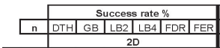
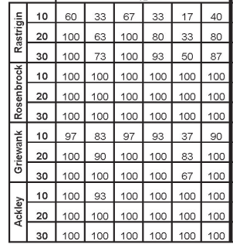
Results
Notes:
In their tests this led to equivalent or higher success rates compared to the other topologies. Using the distance of the particles allowed the Swarm to better search the search space as particles in the same general area were able to work together and more thoroughly examine the local space. For lower dimension problem, this appears to be a great tool to maximize the success of your PSO algorithm.

Slide 13
Problem
Delaunay Triangulation in 2D
O(nlogn)
Delaunay Triangulation in 4D+
O(n^{[d/2]+1})
Notes:
There is a caveat to this is the Delaunay Triangulation becomes increasingly difficult to compute in higher dimensions since the tricks used in lower dimensions no longer apply.
The algorithm is perfectly fine to use in 2, 3 and possibly 4 dimensional problems, however becomes increasingly less useful as the dimensions increase

Slide 14
Solution
CPSO
Notes:
Fortunately, there already is a way limiting the dimensions of a problem and that is through the use of CPSO (or Cooperative PSO). Like Delaunay Triangulation, PSO too struggles with high dimension problems. To combat this, CPSO instead divides the high dimension problem into a number of smaller problems and optimizes them separately. It then merges the results at the end and returns that solution.

Slide 15

CPSO using spatially significant Neighbors
Notes:
This brings us to the topic of my thesis. By combining the power of Cooperative Particle Swarm Optimization with the success of spatially meaningful neighbors, we are able to divide high dimension problems into a number of 2 or 3 dimension problems to better make use of the benefits that Delaunay Triangulation gives.
This will allow us to expand this finding to a larger number of problems and ultimately make the new topology more useful.

Slide 16
CPSO Variants
CPSO-S
CPSO-S_{k}
CPSO-R_{k}
CPSO-H_{k}
Notes:
There are a number of CPSO variants that will be tested.
CPSO-S simply divides each dimension into multiple 1 dimensional PSOs
CPSO-Sk evenly divides the problem into k smaller problems
CPSO-Rk randomly divides the problem into k smaller problems
And CPSO-Hk (also known as Hybrid CPSO) simultaneously runs a standard PSO and swaps information between that and the CPSO

Slide 17
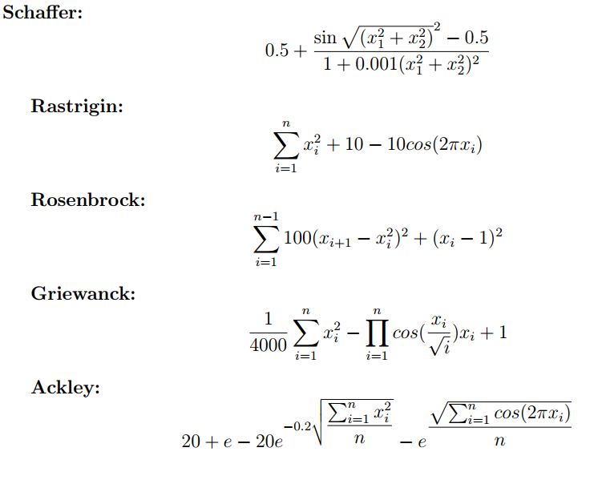
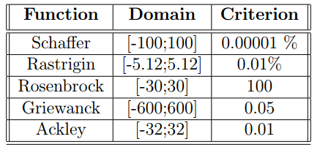
Tests
Notes:
Consistent with the CPSO papers, I will run the CPSO variants against the following optimization functions. I will test both with and without the neighbor topology, testing the success rate and the number of iterations required to reach the criterion. This will help me determine if the use of spatially significant neighbors provide a significant enough boost to the CPSO algorithms to warrant the continued use with these algorithms.

